Slide 1
In re ENV, Docket No. SP09-403, Planning Commission File No. 2008/SUP-2 Decisionmaking
Ko Olina Community Association and Senator Maile Shimabukuro

Slide 2
History
Prior to May 2012
Over 12 Hearing Days
Close to 20 Witnesses
More than 300 Exhibits
After May 2012
0 Evidentiary Hearing Days
0 Witnesses
0 Exhibits

Slide 3
Community Investment
Senator Maile Shimabukuro testified that her constituents and fellow legislators have voiced their opposition to the Landfill.
2011AP 4/4/12 Tr. at 124:25–126:10 (Shimabukuro).
“Please represent us properly and make it known that we do not want to continue to be the dumping ground for the state.”
2011AP Ex. K143 (Richard Medeiros).
“As a resident[] of Waianae, we are very unhappy with what has happened with the medical waste washing down the Waimanalo Gulch Landfill and have written a letter of concern. At almost every meeting of residents (golf course, Curves Waianae, family gatherings), what has happened at the landfill is a hot topic; therefore it is not just our concern, but a concern of our entire community.”
2011AP Ex. K141 (Dennis and Katherine Kamada).

Slide 4
Community Investment
Ken Williams, President of KOCA, submitted direct written testimony describing the concerns of KOCA’s members.
2011AP Williams Direct Written Testimony at ¶¶ 29-35.
“The communities on the Leeward side have experienced more and more environmental degradation . . . , recent environmental hazards . . . , and economic loss . . . We have watched as the City and County have done little and then asked for extension after extension.”
2011AP Ex. K117 (William and Sara Barnes).
“Every day I see the plastic bags blowing from the garbage trucks going to landfill which because of our trade winds on this side of the island [,] inevitably end up in our once pristine waters off Ko Olina. I have seen first hand the results of last year’s floods and the carnage thrown into our ocean because of poor management.”
2011AP Ex. K121 (Chuck Krause, Ko Olina Marina General Manager).

Slide 5
Do It the Right Way
Procedurally
LUC Remand Instructions
Attestation Requirement and New Commissioner
Decisionmaking before the Planning Commission
Conditions Imposed

Slide 6
LUC Instructions
“(2) clarify the basis of the Planning Commission’s proposed additional Condition No. 3, which specifies a December 31, 2022, date within which the Applicant is to identify an alternative site that will be used upon the WGSL reaching its capacity and the implications it has on the closure date of the WGSL to use and the subsequent commencement of operations at the alternative landfill site . . . .”
“(3) clarify whether the record needs to include updated information on the operation of the WGSL, the landfill site selection process, and the waste diversion efforts of the City and County of Honolulu . . . .”

Slide 7
Motions to Reopen
4/27/12: KOCA’s Motion to Reopen (re two site selection documents).
Denied 10/12/16.
11/22/17: KOCA’s Motion to Reopen (re site selection, waste diversion, capacity, and operations).
Denied 10/12/16.

Slide 8
Procedural Errors
What was supposed to happen | What actually happened
Before voting to adopt proposed decision, all commissioners attest that they have reviewed the transcript and studied, examined, and understand the record. (Rule § 2-76) | Proposed decision was adopted before Commissioner Goo was even appointed. Attestation was made after proposed decision was adopted.
After attestation has been made and proposed decision adopted, parties adversely affected by decision given opportunity to file written exceptions and present oral argument. (Rule § 2-75) | Proposed decision was adopted and written exceptions were made before attestation.

Slide 9
Lack of Transparency
VICE CHAIR ANDERSON: Commissioner Hayashida, do you agree with, I guess the dialog back and forth that it be--
MEMBER HAYASHIDA: I’d have to refresh my memory on the time of completion of the seven year before I make that decision whether we’re going to put that into the record. So--
VICE CHAIR ANDERSON: Okay.
MEMBER HAYASHIDA: Shall we make the motion to continue this hearing on another date?
VICE CHAIR ANDERSON: Okay.
Ex. 6 (2/28/19 Tr.) at 98:4-99:5

Slide 10
Lack of Transparency
The “one condition of them all that we’ve reviewed it appears that requires further research on our own to look back through testimony and documentation is that of 3.a, 3.b, and 3.c within KOCA’s [exceptions] . . . .”
Ex. 6 (2/28/19 Tr.) at 100:4-7 (Anderson).

Slide 11
Lack of Transparency
“I believe there was consensus on KOCA’s condition of 1c, 2c, 2d, 2e, 2g, 2i, 2j. And the three items that we’re looking into now are 3a, 3b, and 3c regarding the closure timeline, which we can all agree is fairly critical.”
Ex. 7 (4/11/19 Tr.) at 17:5-6 (Anderson).

Slide 12
Lack of Transparency
“I have 3a, 3b, 3c in front of us. I think as far as the sequencing I’m comfortable with, it's just the timing that we can discuss.”
Ex. 7 (4/11/19 Tr.) at 17:5-6 (Anderson).

Slide 13
Lack of Transparency
MEMBER HAYASHIDA: I think that someone has to present evidence from the record that says [this closure condition] is necessary.
. . .
MR. CHIPCHASE: So we will pull up the evidence regarding the timing for siting a new landfill in a moment here.
VICE CHAIR ANDERSON: Okay.
MR. CHIPCHASE: And it will have record citations.
. . .
MS. CHAN: I’m sorry, could we get some clarification. Are we allowing the parties further argument or is the Commission in discussion?
Ex. 7 (4/11/19 Tr.) at 17:15-18:5

Slide 14
Lack of Transparency
MEMBER HAYASHIDA: Show me the evidence, and then we can discuss it.
VICE CHAIR ANDERSON: Okay.
MR. CHIPCHASE: Chris, you want to pull up the references.
MEMBER HAYASHIDA: I think that’s internal for our Commissioners.
Ex. 7 (4/11/19 Tr.) at 18:15-21

Slide 15
Lack of Transparency
MEMBER McMURDO: Am I the only one feels that there should be a time line?
MEMBER HAYASHIDA: Does the record support the time line decision?
MEMBER McMURDO: I believe so.
Ex. 7 (4/11/19 Tr.) at 26:2-6

Slide 16
Lack of Transparency
“COMMISSIONER GOO: Time line was a long time ago, but it’s in the records.”
Ex. 7 (4/11/19 Tr.) at 26:9-10.
“VICE CHAIR ANDERSON: And I think, as I said earlier, it does appear that there’s evidence that can be construed in either matter on both sides of the coin.”
Ex. 7 (4/11/19 Tr.) at 26:20-23.

Slide 17
Lack of Transparency
“The issues of public trust in government are magnified in this case, because the Applicant is itself a government agency. Holding government agencies to their commitments, and enforcing the law and previously imposed conditions on other government agencies is of primary importance in this case.”
“At the very least, in this case, the OP recommends that the LUC correct the entitlement record for the WGSL by limiting the term of the SUP and re-imposing the applicable requirements that have been violated for so long, and in so doing, help to rebuild public trust in Hawaii’s land use entitlement processes.”
9/22/09 Letter from OP to LUC at 10.

Slide 18
Lack of Transparency
Executive Session
No Explanation of Basis for Decision

Slide 19
What ENV Wants
For a New Special Use Permit to Supersede Existing Special Use Permit to Allow A 92.5-Acre Expansion and Time Extension for Waimānalo Gulch Sanitary Landfill, Waimānalo Gulch, O‘ahu, Hawai‘i, Tax Map Key: 9-2-03: 72 And 73
Key requests:
200 acres
All MSW and ash and residue
No closure deadline

Slide 20
Standards
The proposed use must be unusual and reasonable. HRS § 205-6(a).
“In contested cases: . . . . the party initiating the proceeding shall have the burden of proof . . . .” HRS § 91-10.

Slide 21
Standards
Such us shall not be contrary to the objectives sought to be accomplished by the state land use law and regulations.
That the desired use would not adversely affect the surrounding property.
Such use would not unreasonably burden public agencies to provide roads and streets, sewers, water, drainage and school improvements, and police and fire protection.
Unusual conditions, trends and needs have arisen since the district boundaries and regulations were established.
That the land upon which the proposed use is sought is unsuited for the uses permitted within the district.
Planning Commission Rule § 2-45; HAR § 15-15-95.

Slide 22
Standards
“Planning for the State’s physical environment with regard to land-based, shoreline, and marine resources shall be directed towards achievement of the following objectives: . . . Manage natural resources and environs to encourage their beneficial and multiple use without generating costly or irreparable environmental damage.”
HRS § 226-11(a).

Slide 23
Standards
“To achieve the land, air, and water quality objectives, it shall be the policy of this State to: . . . Promote effective measures to achieve desired quality in Hawaii’s surface, ground, and coastal waters.”
HRS § 226-13(b).

Slide 24
Standards
“To achieve the land, air, and water quality objectives, it shall be the policy of this State to: . . . Reduce the threat to life and property from erosion, flooding, tsunamis, hurricanes, earthquakes, volcanic eruptions, and other natural or man-induced hazards and disasters.”
HRS § 226-13(b).

Slide 25
Standards
“The county planning commission may impose such protective conditions as it deems necessary in the issuance of a special use permit. The county planning commission shall establish, among other conditions, . . . if appropriate, a time limit for the duration of the particular use, which shall be a condition of the special permit.”
HAR § 15-15-95(e).
“[U]nlimited use of the special permit to effectuate essentially what amounts to a boundary change would undermine the protection from piecemeal changes to the zoning scheme guaranteed landowners by the more extensive procedural protections of boundary amendment statutes.”
Neighborhood Bd. No. 24 (Waianae Coast) v. State Land Use Comm’n, 64 Haw. 265, 639 P.2d 1097 (1982).

Slide 26
Standards
Planning Commission Guidelines: “That the desired use would not adversely affect surrounding property.”
Hon. Planning Comm’n R. § 2-45; accord HAR § 15-15-95(b).

Slide 27
Standards
“The planning commission may attach such conditions to any special use permit as it considers necessary to protect the public health, safety and welfare.”
Hon. Planning Comm’n R. § 2-46(e); accord HRS § 205-6(c).
“The [LUC] may impose additional restrictions as may be necessary or appropriate in granting the approval, including the adherence to representations made by the petitioner.”
Haw. Admin. R. § 15-15-96(a).

Slide 28
Proposed Conditions
Operations
Reporting and Enforcement
Diversion of Waste
Closure

Slide 29
Operations - Consensus on Condition 2c
“I believe there was consensus on KOCA’s condition of 1c, 2c, 2d, 2e, 2g, 2i, 2j.”
Ex. 7 (4/11/19 Tr.) at 17:5-6 (Anderson).

Slide 30
Operations - Reg. Compliance
KOCA Condition 2.c: “The operations of the Landfill shall be in compliance with the requirements of Revised Ordinances of Honolulu § 21-5.680, to the extent applicable, and all applicable statutes, rules and regulations of the State Department of Health, the United States Environmental Protection Agency and any other federal or state agency and the Solid Waste Management Permit for the Landfill. A violation of any applicable statute, rule or regulation or any violation of a condition of the Solid Waste Management Permit for the Landfill shall be a violation of this Order.”
Patterned after “Incorporated” PC Condition 7: “The operations of the WGSL under 2008/SUP-2 shall be in compliance with the requirements of Section 21-5.680 of the Revised Ordinances of the City and County of Honolulu 1990, to the extent applicable, and any and all applicable rules and regulations of the State Department of Health.”

Slide 31
Operations
Department of Health Violations
1/31/06 NOV with 18 counts
2011AP Ex. K59.
10/25/06 Warning Letter
2011AP Ex. K101.
5/3/07 Warning Letter
2011AP Ex. K125.
9/5/08 Warning Letter
2011AP Ex. K82.
5/13/10 NOV
2011AP Ex. K66.

Slide 32
Operations
Environmental Protection Agency Violations
4/5/06 NOV
2011AP Ex. K60.
11/29/11 NOV for violating the Clean Water Act
2011AP Ex. K123.

Slide 33
Operations
Falsified wellhead gas readings.
2011AP 1/11/12 Tr. at 91:6–10 (Steinberger).
Failed to collect actual data from mid-2010 to August 2011.
2011AP 1/11/12 Tr. at 91:22–92:3 (Steinberger); 2011AP Steinberger Written Direct Testimony at 27 (¶ 82).

Slide 34
Operations
“There is a pending enforcement case which I can’t speak to in any detail regarding the handling of storm water runoff from the landfill.”
2011AP 4/4/12 Tr. at 156:20–22 (Gill).
“There is . . . , to be clear, potential enforcement action regarding the events around the flood event at the landfill.”
4/4/12 Tr. at 157:10–12 (Gill).

Slide 35
Operations
“Q. Looking at those other landfills, are you aware of any that have had as many findings of violation as Waimanalo Gulch Sanitary Landfill in that same five-year period? A. In the last five years, probably not.”
2011AP 1/25/12 Tr. at 39:24–40:3 (Chang).
“I have not worked on a site that has had anywhere near violations of this size.”
2011AP 3/7/12 Tr. at 133:24–134:1 (Miller).

Slide 36
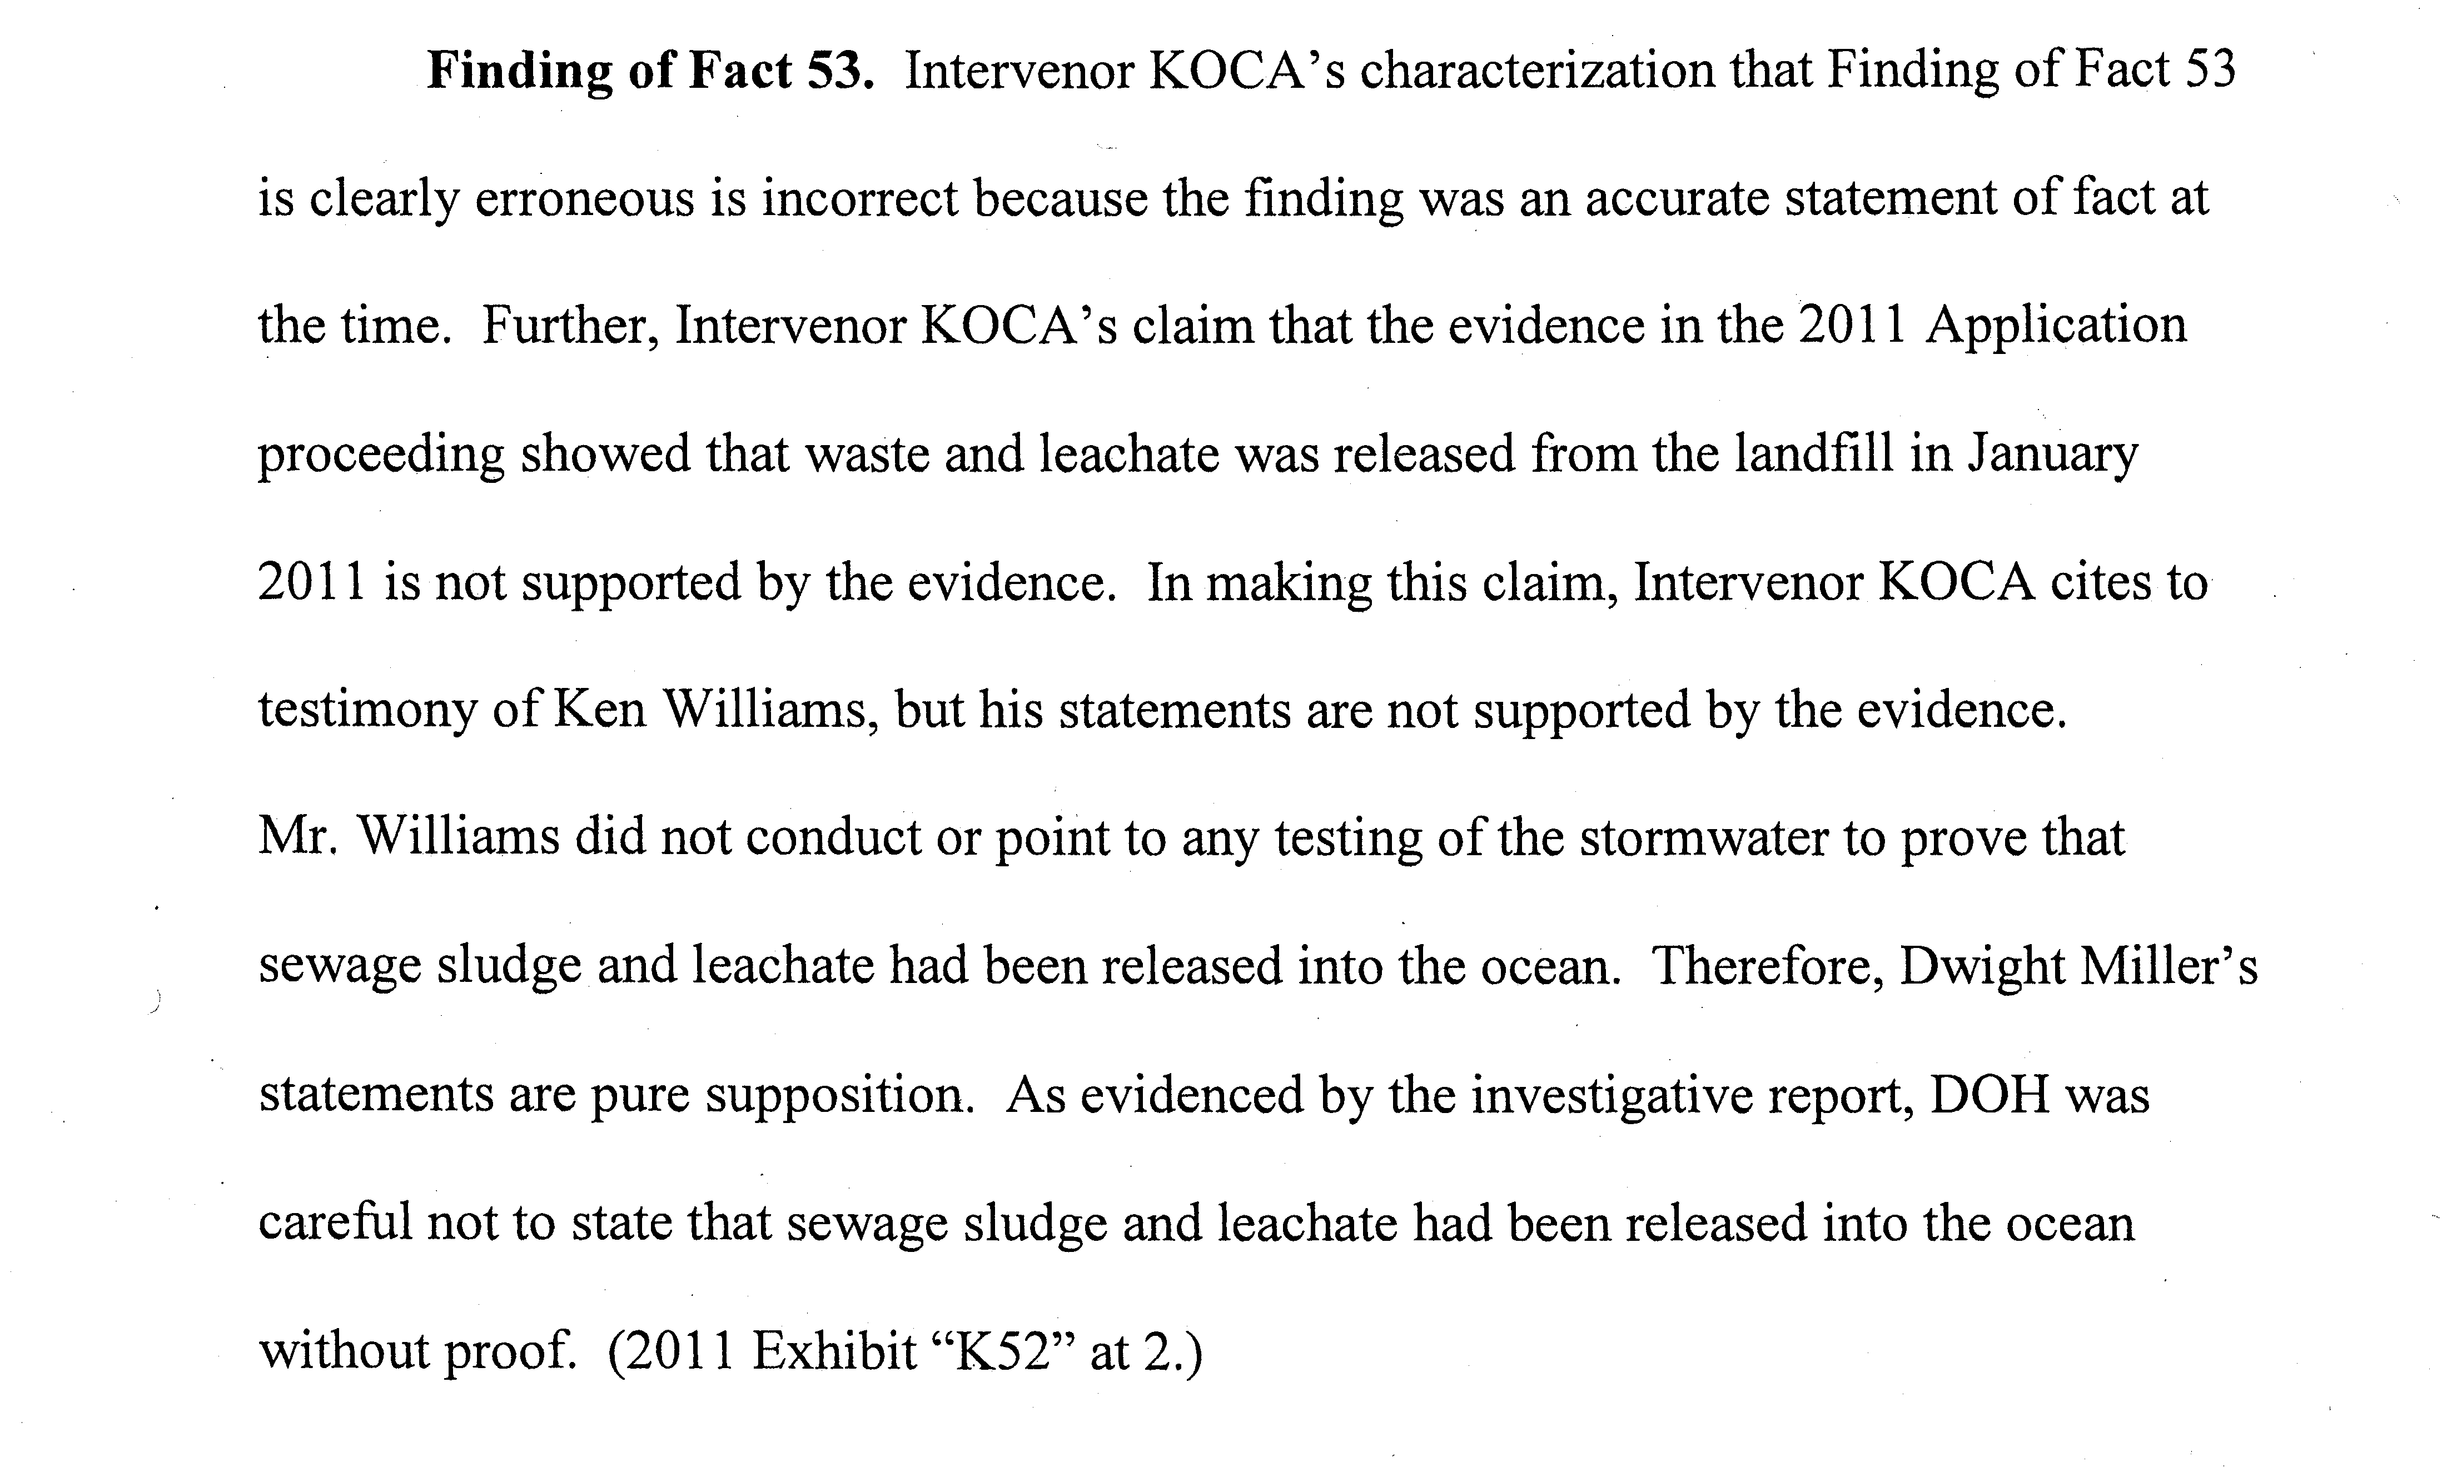
Operations
“Intervenor KOCA’s claim that the evidence in the 2011 Application proceeding showed that waste and leachate was released from the landfill in January 2011 is not supported by the evidence.”
ENV’s Response to KOCA’s Objections at 18.

Slide 37
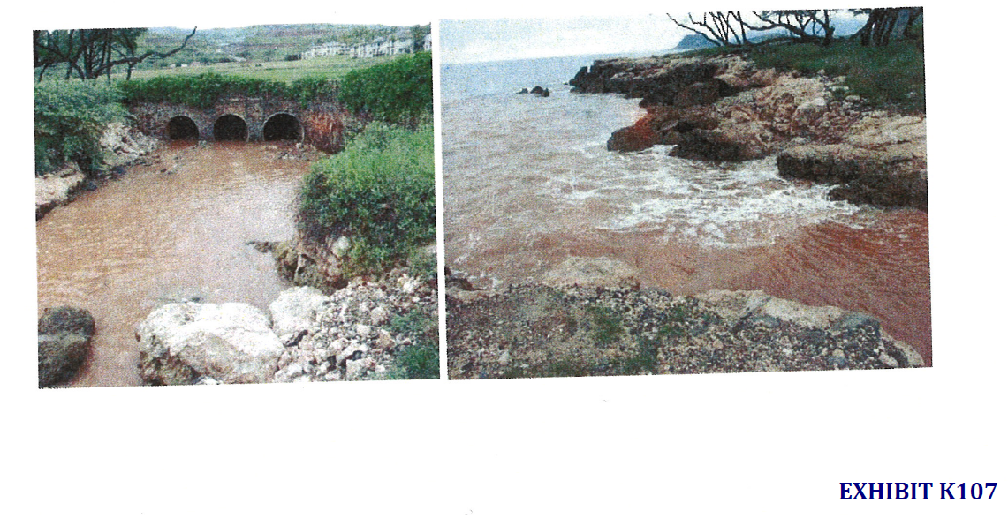

Slide 38
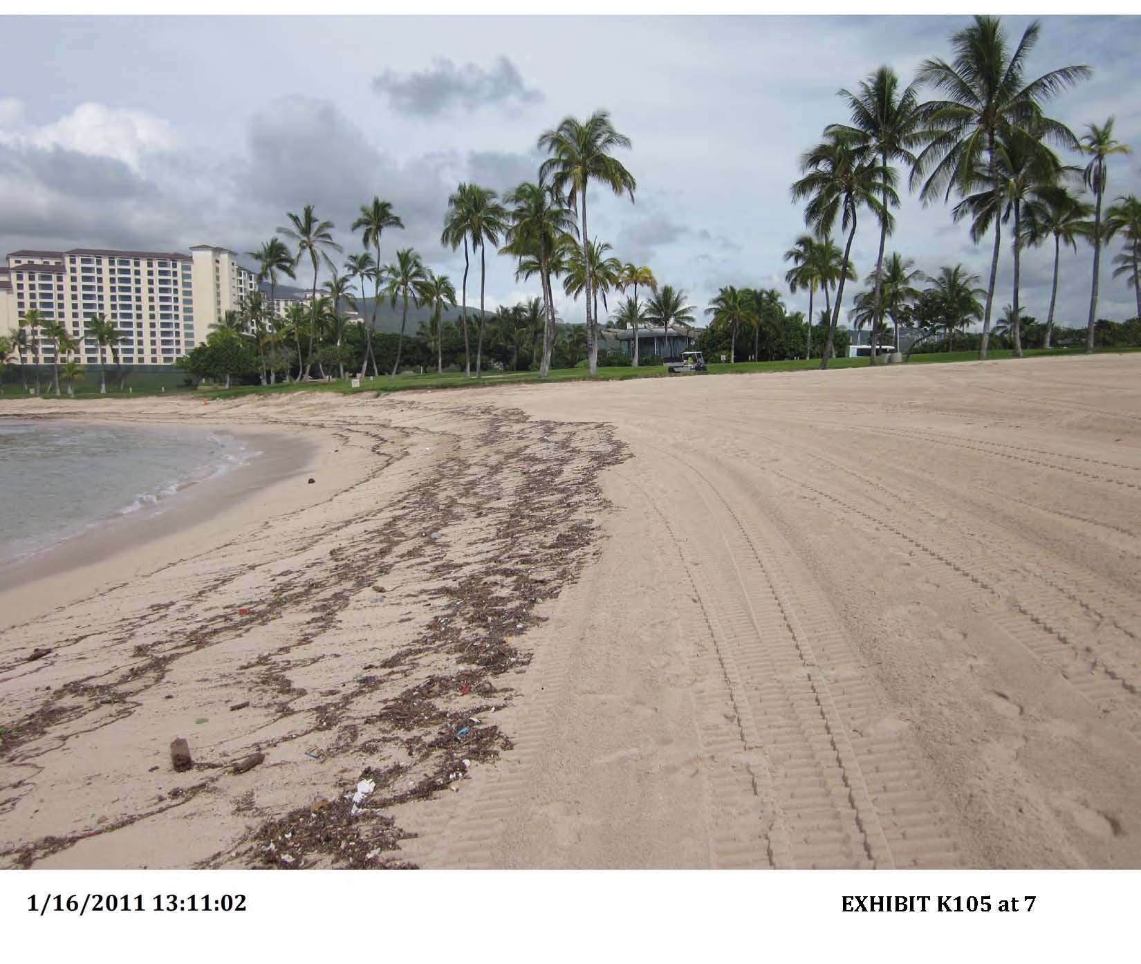

Slide 39
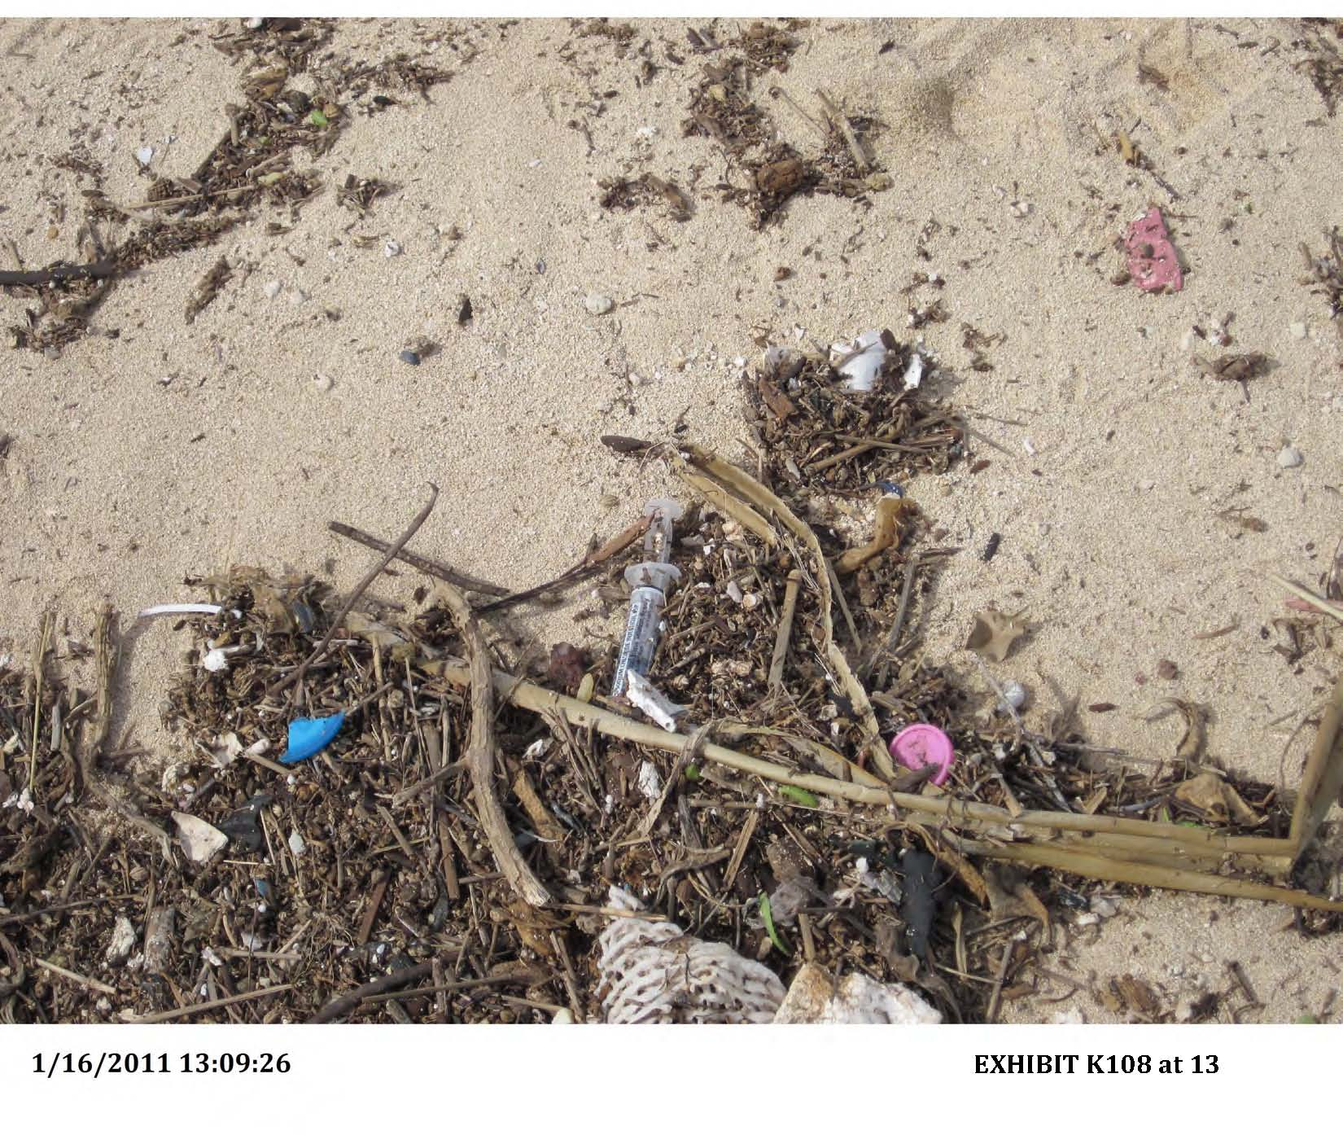

Slide 41
Operations
Director Steinberger testified: “Unfortunately, the torrential rains in December 2010 and January 2011 occurred before the Western Surface Water Drainage System was completed.. Consequently, the active cell was inundated with stormwater and the force and quantity of stormwater breached the cell, causing a release of MSW, including treated medical waste, into the stormwater and into the ocean. The City has been cooperating with Federal and State investigations concerning the release of MSW.”
Steinberger Written Direct Testimony at 26.

Slide 42
Operations
11/29/11 EPA NOV: “[I]n . . . at least three occasions associated with storm events in December, 2010 and January, 2011, Respondents • Failed to prevent run-off of surface water that had contacted waste, • Failed to control erosion to prevent loss of cover or washout of refuse slopes, • Failed to properly manage leachate, and • Failed to adequately retain and remove silt from surface water before it was discharged from the site.”
2011AP Ex. K123 (11/29/11 NOV at 5).
We need to ensure compliance with all state and federal requirements.

Slide 43
Operations - Consensus on Condition 2d
“I believe there was consensus on KOCA’s condition of 1c, 2c, 2d, 2e, 2g, 2i, 2j.”
Ex. 7 (4/11/19 Tr.) at 17:5-6 (Anderson).

Slide 44
Operations – Agency Approvals
KOCA Condition 2.d: “The ENV shall obtain all necessary approvals from the United States Environmental Protection Agency, the State Department of Health, the State Department of Transportation, the State Commission on Water Resource Management, the City and County of Honolulu Board of Water Supply and any other federal, state or municipal agency prior to commencing any onsite or off-site improvements or activities.”
Patterned after “Incorporated” LUC Condition 1: “The Applicant shall obtain all necessary approvals from the State Department of Health, Department of Transportation, Commission on Water Resource Management, and Board of Water Supply for all onsite and offsite improvements involving access, storm drainage, leachate control water, well construction, and wastewater disposal.”

Slide 45
Consensus on Condition 2e
“I believe there was consensus on KOCA’s condition of 1c, 2c, 2d, 2e, 2g, 2i, 2j.”
Ex. 7 (4/11/19 Tr.) at 17:5-6 (Anderson).

Slide 46
Operations - Dust Control
KOCA Condition 2.e: “In accordance with Chapter 11-60.1 of the Hawai‘i Administrative Rules, entitled “Air Pollution Control,” the ENV shall be responsible for ensuring that effective dust control measures during all phases of development, construction and operation of the Landfill are provided to prevent any visible dust emission from impacting surrounding areas. The dust control management plan for the Landfill, which must identify and address all activities that have a potential to generate fugitive dust, is incorporated and made a part of this Order.”
Patterned after “Incorporated” LUC Condition 2: “In accordance with Chapter 11-60.1 ‘Air Pollution Control,’ Hawai‘i Administrative Rules, the Applicant shall be responsible for ensuring that effective dust control measures during all phases of development, construction, and operation of the landfill expansion are provided to minimize or prevent any visible dust emission from impacting surrounding areas. The Applicant shall develop a dust control management plan that identifies and addresses all activities that have a potential to generate fugitive dust.”

Slide 47
Operations
Ko Olina resident Beverly Munson testified that her lanai was covered with dirt every day from the Landfill.
2011AP 2/8/12 Tr. at 59:19–60:8 (Munson).
“Over the years owners in our community and neighboring communities have written letters and made oral testimony about the dirt, debris, and odors generated by the Landfill.”
2011AP Written Direct Testimony of Beverly Munson at 6.

Slide 48
Operations – Visual Blight
KOCA Condition 2.f: “The ENV shall prepare, implement and maintain a landscaping plan for the Landfill that (1) incorporates the features of the surrounding natural landscape and enables the Landfill to blend seamlessly into its environment and (2) reduces erosion and rivulets at the Landfill. Prior to the implementation of the landscaping plan, the ENV shall submit the plan to the Association for review and comment.”

Slide 49
Operations
Ko Olina’s residents, workers and visitors have expressed concerns regarding the visual blight of the Landfill.
2011AP Williams Written Direct Testimony at 9 (¶ 29).
“The dump is a visual blight growing steadily larger on the mountainside above our otherwise pristine resort community.”
2011AP Ex. K120 (8/12/11 letter from Greg Nichols of Ko Olina Golf Club).

Slide 50
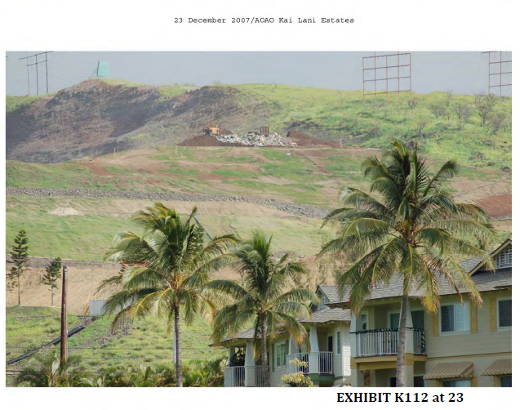

Slide 51
Consensus on Condition 2g
“I believe there was consensus on KOCA’s condition of 1c, 2c, 2d, 2e, 2g, 2i, 2j.”
Ex. 7 (4/11/19 Tr.) at 17:5-6 (Anderson).

Slide 52
Operations - Trucks
KOCA Condition 2.g: “The ENV shall prepare, implement and maintain a schedule pursuant to which City and commercial waste collection and transportation vehicles enter the Landfill without waiting or queuing on Farrington Highway for a period of more than five minutes.”
Ko Olina’s residents, workers and visitors have expressed concerns about heavy truck traffic.
2011AP Williams Written Direct Testimony at 9 (¶ 29).

Slide 53
Operations - Litter
KOCA Condition 2.i: “The ENV shall prepare, implement and maintain a schedule for the weekly monitoring and removal of waste, including but not limited to trash and debris, in the area surrounding the Landfill.”
KOCA Condition 2.j: “The ENV shall monitor whether City and commercial vehicles entering the Landfill have covered and secured their loads to prevent the spilling or scattering of the contents and shall enforce violations.”

Slide 54
Operations - Litter
“For years I have observed rubbish trucks pass the resort with an abundant amount of trash and debris flying from their trucks that litter Farrington Hwy and the resort. We are continuously picking up the debris on a daily basis and found that it is a never ending task to control.”
2011AP Ex. K42 (8/11/11 letter from Alan Nakamura of Ko Olina Golf Course).
Ko Olina’s residents, workers and visitors have expressed concerns regarding windblown litter from the Landfill.
2011AP Williams Written Direct Testimony at 9 (¶ 29).

Slide 55
Operations – Noise and Odor
KOCA Condition 2.h: “The ENV shall prepare, implement and maintain a plan to minimize the emission of noise and odors from the Landfill. With respect to odors, the plan shall include the use of an odor-neutralizing mist system as contemplated by the FEIS.”

Slide 56
Operations – Noise and Odor
The stench of the Landfill has at times been so bad that, if you walk outside, “your throat would actually clench up and your eyes would water.”
2011AP 2/8/12 Tr. at 58:21–24 (Munson).
“Ambiance is very essential and to see debris, such as disposed medical needles, garbage bags coming in from the landfill and the whiff of the sour smell of the landfill across the street is just not one of the impressions we would like to deliver to our clients.”
2011AP Ex.. K45 (8/13/11 letter from Masaki Nagamine of Watabe Wedding Corporation).

Slide 57
Reporting & Enforcement
KOCA Condition 1.f: “The ENV shall report to the public every three months on the efforts of the City in regard to the continued use of the WGSL, including any funding arrangements that are being considered by the City. On the date each report is published, the ENV shall send a copy of the report to the Association.”
Patterned after “Incorporated” LUC Condition 15: “The [ENV] through the City Administration shall report to the public every three months on the efforts of the [ENV] in regard to the continued use of the WGSL, including any funding arrangements that are being considered by the [ENV].”

Slide 58
Reporting & Enforcement
KOCA Condition 1.g: “The ENV shall present to the Planning Commission in a public hearing every six months on the status of the City’s efforts to either reduce or continue the use of the WGSL. The ENV shall provide at least 14 days’ written notice of each hearing to the Association of such hearings.”
Patterned after “Incorporated” LUC Condition 16: “The [ENV] shall have a public hearing every three months to report on the status of their efforts to either reduce or continue the use of the WGSL.”

Slide 59
Reporting & Enforcement
Senator Maile Shimabukuro testified that her constituents and fellow legislators have voiced their opposition to the Landfill.
2011AP 4/4/12 Tr. at 124:25–126:10 (Shimabukuro).
The Waianae Neighborhood Board has voted to close the Landfill.
2011AP 4/4/12 Tr. at 131:12–14 (Shimabukuro).
The Kapolei Neighborhood Board has consistently voted to close or stop the Landfill.
2011AP 3/7/12 Tr. at 134:22–135:1 (Timson).

Slide 60
Reporting & Enforcement
KOCA Condition 1.e: “Within 30 days after each semi-annual report is submitted, the Association may request that the Planning Commission issue an order to show cause why the SUP should not be revoked if there is reason to believe that there has been a failure to perform according to the conditions imposed by this decision and order pursuant to Planning Commission Rule § 2-48. If so requested, the Planning Commission shall issue the order and schedule a hearing. The ENV shall provide the public with at least 14 days’ notice of the hearing by posting the hearing date, time, location and subject matter on the ENV’s website. The ENV shall also provide at least 14 days’ written notice of the hearing to all neighborhood boards on O‘ahu and the Association.”

Slide 61
Diversion of Waste
KOCA Condition 2.b: “The Applicant shall continue its efforts to use alternative technologies to provide a comprehensive waste stream management program that includes H-POWER, plasma arc, plasma gasification and recycling technologies, as appropriate. The Applicant shall also continue its efforts to seek beneficial reuse of stabilized, dewatered sewage sludge. The Applicant shall use alternative technologies, to the extent reasonably practicable, to divert waste from the Landfill as set out in Exhibit A (proposed Stipulation to Continue Proceedings Until April 22, 2017).”
Patterned after “Incorporated” PC Condition 2: “The Applicant shall continue its efforts to use alternative technologies to provide a comprehensive waste stream management program that includes H-POWER, plasma arc, plasma gasification and recycling technologies, as appropriate. The Applicant shall also continue its efforts to seek beneficial reuse of stabilized, dewatered sewage sludge.”

Slide 62
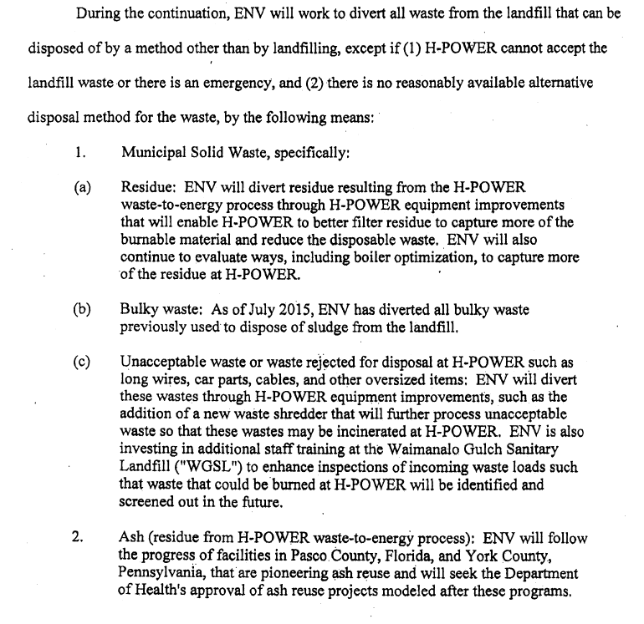

Slide 63
Waste Diversion
KOCA Condition 3.a: “From the date of this Order until March 1, 2024, MSW, including sewage sludge, may not be deposited at WGSL unless it cannot be disposed of within the City by any means other than landfilling; provided, however, that (1) during periods of H-POWER scheduled maintenance when the facility may shut down one or more of the boilers, MSW that would otherwise be processed at H-POWER or other facilities may be disposed of at WGSL, and (2) under emergency circumstances, as reasonably determined by the Director of the ENV, MSW that would otherwise be processed at H-POWER or other facilities may be disposed of at the WGSL.”

Slide 64
Waste Diversion
The ENV’s 2012 Findings:
“1. MSW, including sewage sludge under the control of the City, that can be disposed of other than by landfilling, shall be allowed at the WGSL up to January 1, 2014, provided HPOWER or other facility is capable of processing the MSW, including sewage sludge under the control of the City.
2. During periods of HPOWER scheduled maintenance when the facility may shut down one or more of its boilers, MSW, including sewage sludge, that would otherwise be processed at HPOWER or other facilities may be disposed of at WGSL.
3. Under emergency circumstances, as reasonably determined by the Director of the Department of Environmental Services, MSW, including sewage sludge, that would otherwise be processed at HPOWER or other facilities may be disposed of at WGSL.”

Slide 65
Closure
PC Condition 1: “On December 31, 2022, the Applicant shall identify an alternative landfill site that may be used upon Waimanalo Gulch Sanitary Landfill reaching its capacity at a future date. This identification shall have no impact on the closure date for the Waimanalo Gulch Sanitary Landfill because the Waimanalo Gulch Sanitary Landfill shall continue to operate until it reaches capacity.”

Slide 66
Closure
LUC’s Counsel: “[I]f you gave the county the unfettered, indefinite use of a Special Use Permit for the refuse placement, what you would have done is what that Neighborhood Board 24 decision says you cannot do. You cannot use a Special Use Permit process to get a boundary amendment . . . .”
“[Absent a closure condition], they have an unfettered Special Use Permit for an indefinite period of time, what you would have been doing or what the commission would have been doing would be to violate the Chapter 205 because you would have given them a boundary amendment as opposed to a Special Use Permit.”
7/14/2010 Tr. at 67-69 (Russell Suzuki).

Slide 67
Closure
“In this case, although the type of use is limited, the duration is not. The issuance of a limited-term SUP for a landfill is an appropriate use of the SUP process. The issuance of an SUP with an unlimited term identically resembles the intended outcome of the district boundary amendment petition (A08-780) filed by the ENV and currently being heard by the LUC. The OP believes that CPC has overstepped the bounds of its authority in issuing a SUP without a firm time limit for operations.”
9/22/2009 Office of Planning Letter to LUC.

Slide 68
Closure
Stage 2: March 2, 2024, to March 1, 2027
KOCA Condition 3.b: “From March 2, 2024, until March 1, 2027, WGSL shall be closed to use and all waste except (1) ash and residue from H-POWER; and (2) automobile-shredder residue.”

Slide 69
Closure
Stage 3: March 2, 2027 Onwards
KOCA Condition 3.c: “The Landfill shall stop accepting any form of waste and close on or before March 2, 2027.”
KOCA Condition 4: “The ENV shall file with the Planning Commission an approved closure plan one year prior to closing to all forms of waste on March 2, 2027.”

Slide 70
Closure
June 2003: LUC orders landfill to be closed by May 1, 2008.
2011AP Ex. K2 at 10 (6/9/03 LUC Order).
March 2008: LUC amends closure deadline to November 1, 2009.
2011AP Ex. K155 at 18 (3/14/08 LUC Order).
October 2009: LUC orders that after July 31, 2012, only ash and residue from HPOWER shall be allowed at WGSL.
LUC’s 2009 decision.

Slide 71
Closure
It should take 18 months to two years for design, design review, and development of a landfill.
2011AP 3/7/12 Tr. at 199:24–200:1 (Miller).
The EIS process should take a year to a year and a half.
2011AP 3/7/12 Tr. at 201:1–24 (Miller).
Adding land acquisition to the process, it would probably take a total of three to five years.
2011AP 3/7/12 Tr. at 202:14–203:1 (Miller).

Slide 72
Closure
“We have asked for a five-year extension because that’s the time that we believe it’s going to take in order for us to establish a new landfill.”
Ex. K85 at 95:6–8 (Doyle).
“We think the time that is necessary for us to get us there is at least three, probably four years just to get ourselves up and operational on that landfill site.”
2011AP Ex. K85 at 100:23–25 (Doyle).

Slide 73
Closure
“Incorporated” LUC Condition 4:
“On or before November 1, 2010, the Applicant shall begin to identify and develop one or more new landfill sites that shall either replace or supplement the WGSL. The Applicant's effort to identify and develop such site shall be performed with reasonable diligence, and the Honolulu City Council is encouraged to work cooperatively with the Applicant’s effort to select a new landfill site on Oahu. Upon the selection of a new landfill site or sites on Oahu, the Applicant shall provide written notice to the Planning Commission. Upon receipt of such written notice, the Planning Commission shall hold a public hearing to reevaluate 2008/5UP-2 (SP09403) and shall determine whether modification or revocation of 2008/SUP-2 (SP09-403) is appropriate at that time. The Planning Commission shall make a recommendation to the Land Use Commission.”

Slide 74
Closure
“There is nothing in the record to justify closing WGSL before it reaches capacity and incurring the otherwise avoidable costs of establishing a landfill elsewhere . . . .”
ENV response to KOCA’s Objections at 14.

Slide 75
Closure
“After numerous lengthy meetings within the community, in June or July of 2002[,] [former acting ENV Director Frank Doyle] stated to the community that, if the community allowed some expansion of the Landfill, the ENV would commit to close the Waimanalo Gulch Sanitary Landfill in 2008.”
2011AP Rezentes Written Direct Testimony at 4 (¶ 12).
“COMMISSIONER COPA: Do you honestly think that we will have a site, another site picked for a landfill? And if so do you think that you could commit that without a doubt that this landfill will close? MR. DOYLE: We have made that commitment, yes.”
2011AP Ex. K85 at 125:7–11 (3/27/03 Tr.).

Slide 76
Closure
“The process of allowing [the City] to simply amend or eliminate conditions when they become too onerous to comply with risks undermining the meaning and integrity of our land use entitlement processes, and with it, the public trust in government.”
9/22/2009 Office of Planning Letter to LUC at 10.
“[A]t some point in time we’ve got to say enough is enough.”
2011AP 2/8/12 Tr. at 77:14–16 (Rezentes).

